Slide 1
Introduction to NLP
CS 263: Natural Language Processing
Nanyun (Violet) Peng
Course website: https://vnpeng.net/cs263_sp24.html
syllabus,
announcements,
slides,
homework
1

Slide 2
Announcements
Please check the syllabus before taking this course.
I’m unlikely to be able to provide PTEs unless some students drop the class.
If you’re interested in enrolling, please go to the website http://web.cs.ucla.edu/classes/enroll/ to find explanations of the process and a form you can fill out to express your interest so that OASA can see the demand and work to do what they can to address it.
You can audit this course and participate in discussions even if you’re not enrolled.
2

Slide 3
Staff
Instructor: Nanyun (Violet) Peng
Email: violetpeng@cs.ucla.edu
Office hour: 12pm – 1pm, Monday at Eng VI 397A; or zoom: link.
TAs:
Christina Chance
Email: cchance@cs.ucla.edu
Po-Nien Kung
Email: ponienkung@cs.ucla.edu
Elaine Yixin Wan
Email: elaine1wan@g.ucla.edu
Rohan Wadhawan (half TA)
Email: rwadhawan7@g.ucla.edu
3

Slide 4
Who you are?
Department
Stage
Goal (why are you here)
What have you heard about NLP?
4
Notes:
How many are under who have taken my cs162?

Slide 5
This lecture
Course Overview
What is NLP? Why it is important?
What will you learn from this course?
What are the challenges?
Key NLP tasks
State-of-The-Art NLP models
Course Information
5

Slide 6
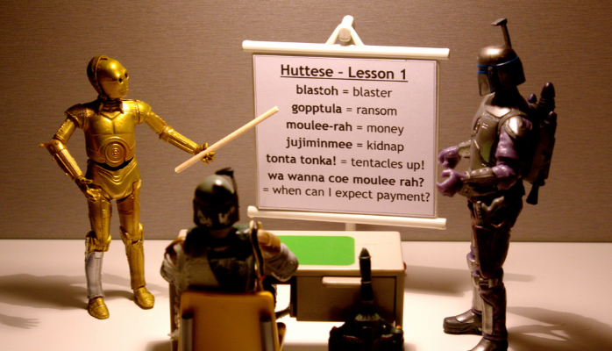
What is NLP
Wiki: Natural language processing (NLP) is a field of computer science, artificial intelligence, and computational linguistics concerned with the interactions between computers and human (natural) languages.
6

Slide 7
Go beyond the keyword matching
Identify the structure and meaning of words, sentences, texts and conversations
Deep understanding of broad language
NLP is all around us
7

Slide 8
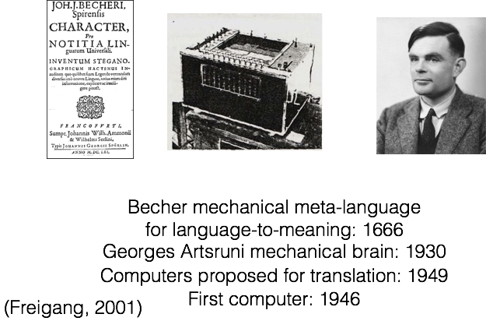
NLP is a pretty old topic!
ACL founded : 1962
1900s

Slide 9
Launched 2006
App 2011
WordLens 2015

Slide 10
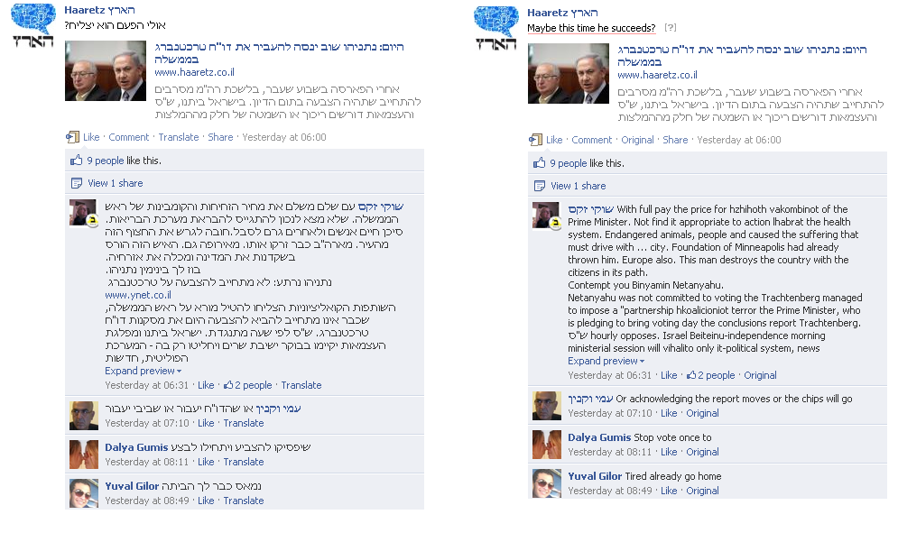
Machine translation
Launched 2011
Facebook translation, image credit: Meedan.org
10

Slide 11
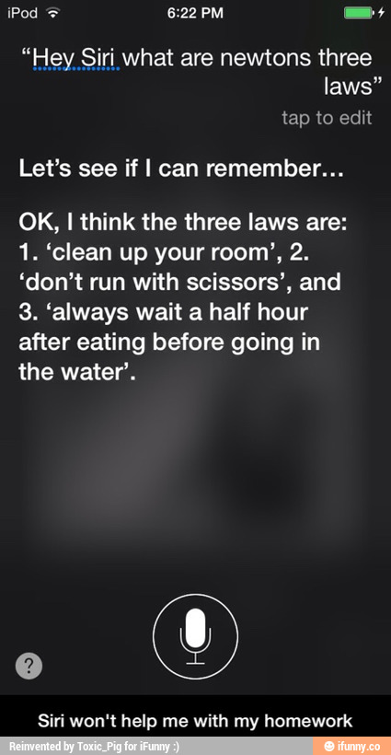
Question answering
October 2011
'Watson' computer wins at 'Jeopardy'
February 2011
credit: ifunny.com
11

Slide 12
Sentiment/Opinion Analysis
First research paper: 2002
TwitrRatr: 2018
12

Slide 13

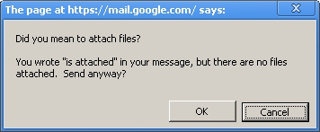
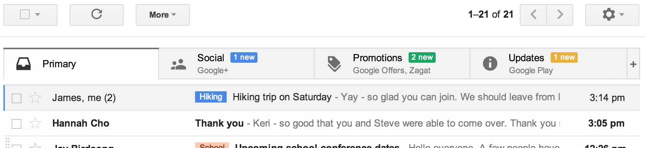
Text Classification
Other applications?
13

Slide 14
Information Extraction
Unstructured text to database entries
Yoav Artzi: Natural language processing
14

Slide 15
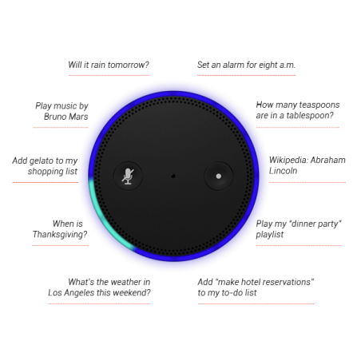
Conversational Assistant Systems
15

Slide 16
My Model Wrote A Sonnet For You!
Tian and Peng, NAACL 2022
The First Natural Language Processing Class
-- By Zest
English was the language that machines have learned
about the class the students learned and earned
listen all the time and get the focus feel
today together deep in thought and real
Professor sitting near the front of room
students listen as the teacher would assume
a face with smile is jumping up between
eyes are staring into my computer screen
Relax in bed and do the college homework
Linguistic methods used in our work
spend a second time for several hours
have been in school experience both are ours
A warm recall during our college year
A job that lead me to a found career

Slide 17
Where else have you seen NLP in your life,
in the news, or elsewhere?

Slide 18
ChatGPT
Let’s have a try! https://chat.openai.com/
Input: When I found out my grandma was in the hospital I felt a particular color. When someone cut me off in traffic I felt a different color. What is the most likely color I would see if I combined these two colors?
Input: Michael is at that really famous museum in France looking at its most famous painting. However, the artist who made this painting just makes Michael think of his favorite cartoon character from his childhood. What was the country of origin of the thing that the cartoon character usually holds in his hand?
https://arxiv.org/pdf/2204.02311.pdf

Slide 19
Goals of the course
Introduce you to NLP problems & solutions
Models, algorithms, and tools that are out there to solve language-related problems you want to tackle
How to design and evaluate your own task/model/algorithm/tool
Using data and statistics
Using your own creativity
Using the latest advances
At the end you should:
Agree that language is subtle & interesting
Feel some ownership over the models/algorithms/tools
Understand research papers in the field

Slide 20
This lecture
Course Overview
What is NLP? Why it is important?
What will you learn from this course?
What are the challenges?
Key NLP components
Course Information
20

Slide 21
Ambiguity: Favorite Headlines
Iraqi Head Seeks Arms
Juvenile Court to Try Shooting Defendant
Teacher Strikes Idle Kids
Stolen Painting Found by Tree
Kids Make Nutritious Snacks
Local High School Dropouts Cut in Half

Slide 22
Named Entity Recognition (NER) and Ambiguity
Type ambiguity
Notes:
Unlike part-of-speech tagging, where there is no segmentation problem since each word gets one tag, the task of named entity recognition is to find and label
spans of text, and is difficult partly because of the ambiguity of segmentation; we need to decide what’s an entity and what isn’t, and where the boundaries are.
Indeed, most words in a text will not be named entities.
Another difficulty is caused by type ambiguity the name Washington can refer to the educator Booker T Washington, the sports team, the location, or the geo-political entity.

Slide 23
Part-of-Speech (POS) Tagging and Ambiguity
“Back” can be an adjective, noun, particle, or verb.
The back door (adjective)
On my back (noun)
Win the voters back (particle)
Promised to back the bill (verb)
Time flies like an arrow.
NN VBZ IN DT NN
VBP NN IN DT NN
NN NN VBP DT NN
Fruit flies like a banana.
NN NN VBP DT NN

Slide 24
Syntactic Parsing and Ambiguity
S
S
NP
VP
NP
VP
Papa
VP
PP
Papa
V
NP
V
NP
P
NP
ate
NP
PP
ate
Det
N
with
Det
N
Det
N
P
NP
the
caviar
a
spoon
the
caviar
with
Det
N
a
spoon

Slide 25
This lecture
Course Overview
What is NLP? Why it is important?
What will you learn from this course?
What are the challenges?
Key NLP components
Course Information
25

Slide 26
Levels of Language
Phonetics/phonology/morphology: what words (or subwords) are we dealing with?
Semantics: What’s the literal meaning?
Syntax: What phrases are we dealing with? Which words modify one another?
Pragmatics: What should you conclude from the fact that I said something? How should you react?

Slide 27
Levels of Language
Phonetics/phonology/morphology: what words (or subwords) are we dealing with?
cat, cats, dog, dogs(z), box, boxes.
Syntax: What phrases are we dealing with? Which words modify one another?
How do words fit together?
S
DT
JJ
NN
the
blue
boat
NP
VP
NN
JJ
DT
the blue boat
sailed home
boat
blue
the
Note similarity to programming languages!

Slide 28
Levels of Language
Semantics: What’s the literal meaning?
What does a sentence mean?
Papa eats the caviar with a spoon.
tool
with a spoon
papa-01: an informal term for a father
eat-01
agent
agent
eat-01: take in solid food
caviar-01: salted roe of sturgeon or other large fish
papa-01
caviar-01
Notes:
Semantic role labeling

Slide 29
Levels of Language
Pragmatics: What should you conclude from the fact that I said something? How should you react?
What does the speaker mean? (context: in a stuffy room)
Can you crack the window a little bit?
No, I do not have a hammer.
Yes, I have the ability to crack the window.
Sure (open the window), does this feel better?

Slide 30
Questions about Intro?
Next is Boring Course Information That Is Very Important

Slide 31
Why You May Not Want To Take This Course
It's not an easy course
Requires basic knowledge of probability, statistics, linear algebra, machine learning, and programming (python)
Need to learn new deep learning frameworks (PyTorch) outside the lecture
We have a research/exploration oriented project
The exam questions will require original thought, not just memorization
If we discover you have cheated, you'll probably get a C- or worse in the course
If you "need" a particular grade in the course, see me now so you can be advised about how realistic your request is.

Slide 32
Cheating
You MAY
talk with other students, friends, or others about your homework assignments IF you acknowledge such discussion in your submission
ask questions about the homework and subject material in the forums
You MAY NOT
copy code or answers from any source including friends, homework/test services, NLP or other software libraries. This includes making slight changes to previously written code
Find solutions to these problems online
Share solutions to these problems online
hack the scoring servers
allow your code to be copied, even if unintentionally
attempt to communicate with or read from any other person or device while taking exams

Slide 33
Cheating
Suspected cheats (including those who were plagiarized from) will be reported to the University. Punishment includes but is not limited to:
Zero on assignment, exam, or class
Loss of career services privileges
Loss of CPT rights

Slide 34
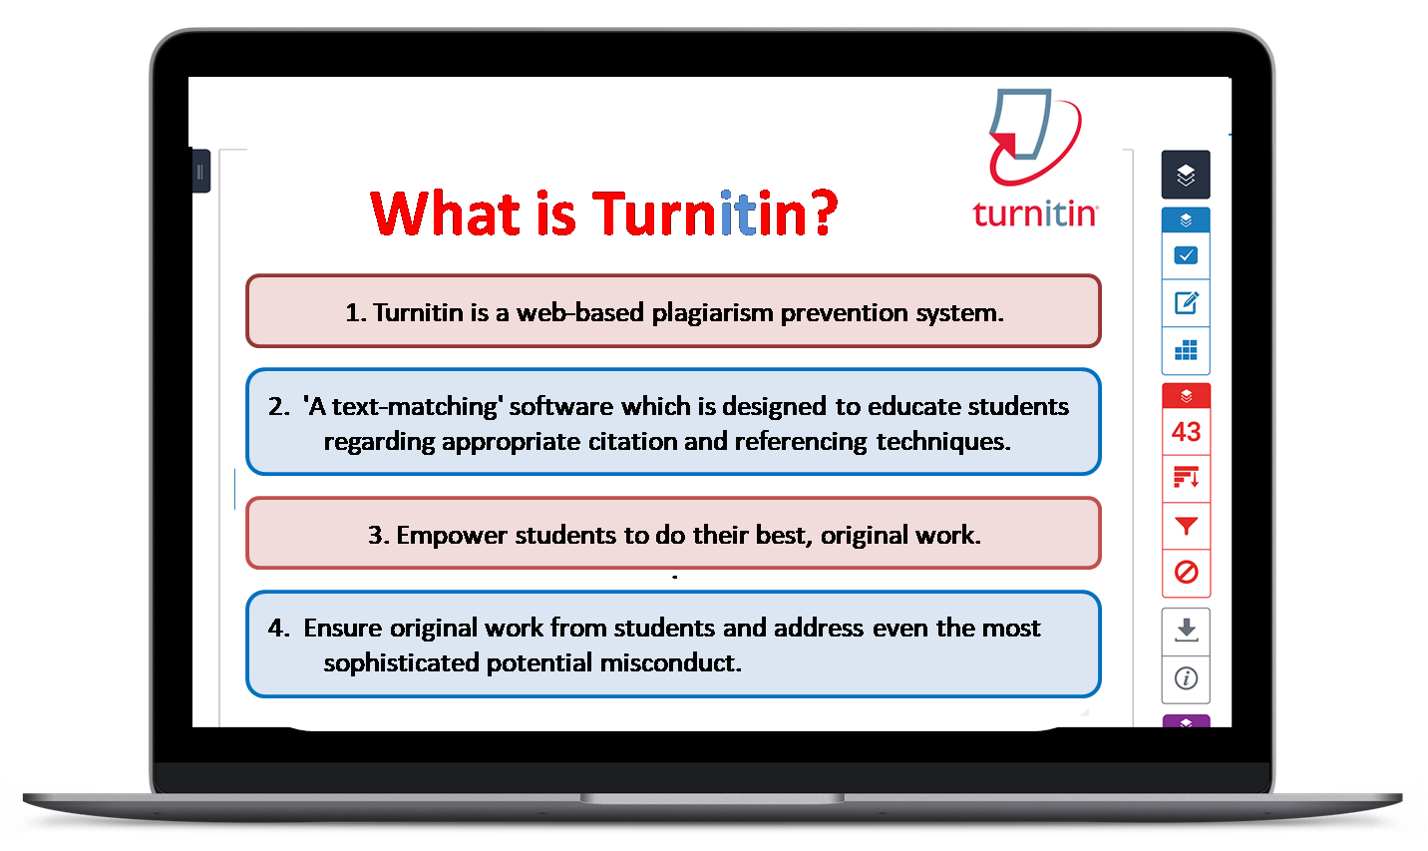
How we catch cheatings? Turnitin!

Slide 35
Support
Piazza Discussion Forums
Signup at https://piazza.com/ucla/spring2024/cs263 access code: miyipf86d0e
TAs and Instructor will monitor regularly, answer questions, engage in discussion
You should answer each others' questions and help your fellow students out!
Outstanding student contributors will receive a grade bump-up as extra credit (e.g. B+ to A-, A- to A)
BruinLearn
Location of homework assignment pdfs
Ultimately, location of grades
BruinLearn → Gradescope
Homework written submission and graded exam review

Slide 36
Syllabus and Schedule
https://vnpeng.net/cs263_sp24.html (bookmark this page!)
Schedule will probably change depending on our speed; check back frequently!
Textbook: Jurafsky and Martin, Speech and Language Processing 3rd edition: https://web.stanford.edu/~jurafsky/slp3/
Additional “textbook” material:
Jacob Eisenstein, Introduction to Natural Language Processing (https://cseweb.ucsd.edu/~nnakashole/teaching/eisenstein-nov18.pdf)
Yoav Goldberg, Neural Network Methods for Natural Language Processing (https://tinyurl.com/3jfn8vpk)
If you have specific issues preventing you from attending the class, email/see me immediately
If you have medical/other accommodation needs email/see me ASAP (well before the midterm)

Slide 37
Lecture and Notes
You don't have to come to class if you don't want to/can't
However, in-person participation is highly recommended, and
We have 5% participation grade
We have very generous policy for active participation with possibility to receive a grade bump
Slides will be posted before class (but they might be updated) on bruinlearn.

Slide 38
Prerequisites
The course materials target CS graduate students.
I expect you to program at the level of a CS undergrad senior or better
Most of the coding assignments will be in Python
I expect you to know or is comfortable learning PyTorch, which is a deep learning framework based on Python
There will be basic probability, statistics, linear algebra, and machine learning (CM146 or equivalent), which will be reviewed as needed

Slide 39
Homework
Two research-oriented homework
they do not overlap (i.e. you will not receive hw2 before hw1 is due).
20% of your grade.
One quarter-long open-ended research project
You can have 2 late days total over the whole course (including for the course project)...
...but no more than 1 per assignment
Late homework thereafter are penalized by 50% for the next 24 hours, then not accepted

Slide 40
Project
There will be an open-ended research project!
Get a team (up to 4) – everyone gets the same grade – if the peer feedback come back without complaints.
The project is open-ended to let you experience “doing research”
Friday’s TA session will be mostly devoted for this + some exam preparation
Several milestones:
teaming, midterm, final reports, final presentation, and peer feedback
Consists of 25% of the grade!
We will have peer review for the final report and presentation
Instructors will give the final grade

Slide 41
Exams
Two in-class exams:
Wednesdays, 4/17 and 5/8, in class, 25% of the grade
short answers, multiple choice, some derivations, some pencil & paper calculations
one single-sided page of notes allowed
Final exam:
6/11, 8:00am-11:00am, location TBD, 25% of the grade
cover the whole class
one double-sided page of notes allowed

Slide 42
Extra Credit
Outstanding in-class participator and piazza contributors may have their grade bumped a category (e.g. B- to B, B+ to A-).
The number of and determination of such contributors is up to the staff and is not eligible for regrade.

Slide 43
Grading/Regrading Policy
No changes are allowed to submitted homework (after the deadline)
If something is clearly wrong, you may request specific regrade of a specific question/part via a google form the TAs will send out.

Slide 44
Next Time...
Lexical Semantics
Distributional semantics theory
Word embeddings
Word2Vec

